Slide 1

Strong Workforce Program Funding
Theresa Rowland, Associate Vice Chancellor Instruction, Workforce & Economic Development
CCSF Flex Day
August 10, 2016

Slide 2
Strong Workforce Program (SWP) Background
SWP Task Force – 25 recommendations November 2015; http://doingwhatmatters.cccco.edu/StrongWorkforce.aspx
Compared to SSSP, SWP is to Strengthen Career and Technical Education (CTE);
Accountability;
$200M annual state funding to CCCs;
Formula is 60% to CC Districts and 40% to Regions;
Year One 2016-17; colleges can spend starting in September 2016;
CCSF 2016-17 allocation = $2.7M
Bay Area Region (28 colleges) 2016-17 allocation = $16.16M
Notes:
2016-17 funds need to be expended by Dec 31, 2018.

Slide 3

“California needs
1 million more
AA, certificates, or industry-valued credentials.”
Widely Recognized Gap
Notes:
It’s true that California needs 1M more students with bachelor degrees. The 4-year system shares that responsibility with us.
It’s equally true that California needs 1M more middle skill credentials – defined as more than a high school degree but less than a bachelors. A.k.a., subbaccalaureate: AA, certificates and industry-valued credentials. There is no tier of education to do this other than the community colleges. If not us, then who else?
Sometimes, it’s not an “either or” – not CTE vs transfer – but if we do this right, you will find its is CTE and transfer . Let me share the story of XXX. He held several jobs in the cash economy before coming to XXX community college. There, he found success in a CTE biotech certificate program and eventually went off to get a PhD.

Slide 4



SSSP & SWP Timelines since 2011
CCCCO Implementation
SSSP
Student Success
Task Force
CCCCO Implementation
SWP
2011
2012
2013
2014
2015
2016
2017
2018
2019
Sept 2016: BOG Approval pending; Accountability Metrics specified and Release of $2.7M for CCSF; $16.6M released for the Bay Region (CCSF is 1 of 28 CCs in the Bay Region and will share a portion of this SWP funding as well).
College and Regional SWP Plans due to CCCCO 1/31/17

Slide 5
SWP Timeline
2014-15 Task Force
November 2015 Task Force Recommendations;
January & May 2016, $200M intact in Governor’s budget;
June 2016 determination of 60/40 split- 60% CCs, 40% Regions;
September 2016 BOG to approve accountability metrics;
September 2016 CCs can begin to spend;
January 31, 2017 District and Regional plans due to CCCCO;

Slide 6
SWP to support CCSF’s role in the regional economy
General Accountability Metrics
  To increase student success in CTE to support workforce gaps;
  Emphasis on increased CTE enrollments and completions;
  Responding to industry innovation and new skills needed;
  Exact guidelines forthcoming from CCCCO.

Slide 7
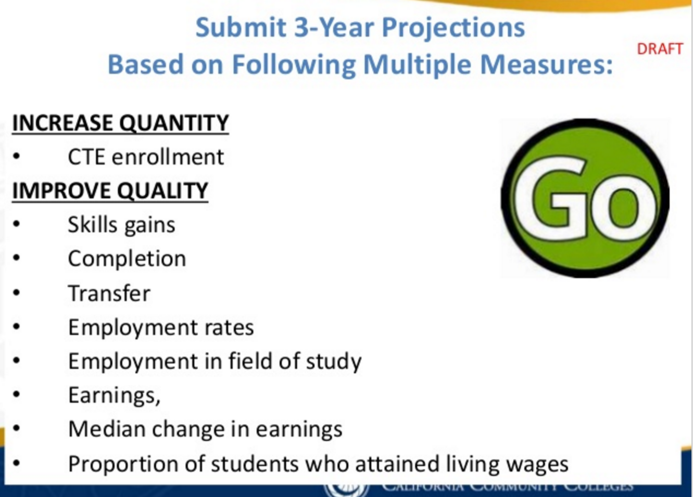

Slide 8
SWP to support CCSF’s role in the regional economy
What does this mean for CCSF?
  Build capacity to serve more CTE students in deeper ways;
  Opportunity for new courses, programs, degrees;
  Increase regional work, linking efforts with other CCs;
  Improving work-based learning, employment, wage increases, and work with Workforce Investment Boards (OEWD here in SF).

Slide 9
Ways to Inform the CCSF SWP Plan
Program Review on innovations and needs;
Labor Market Demands (unfilled jobs);
Linkages with Employers and evidence gathered from Advisory Committees;
Connection points for student internships, apprenticeships, work experience, etc…;
CCSF SWP Task Force:
  Academic Senate appointments;
  Classified appointments;

Slide 10
Discussion
Q/A
Input
For further information:
  Theresa Rowland
  trowland@ccsf.edu

