Slide 1

Strong Workforce Program

Slide 2
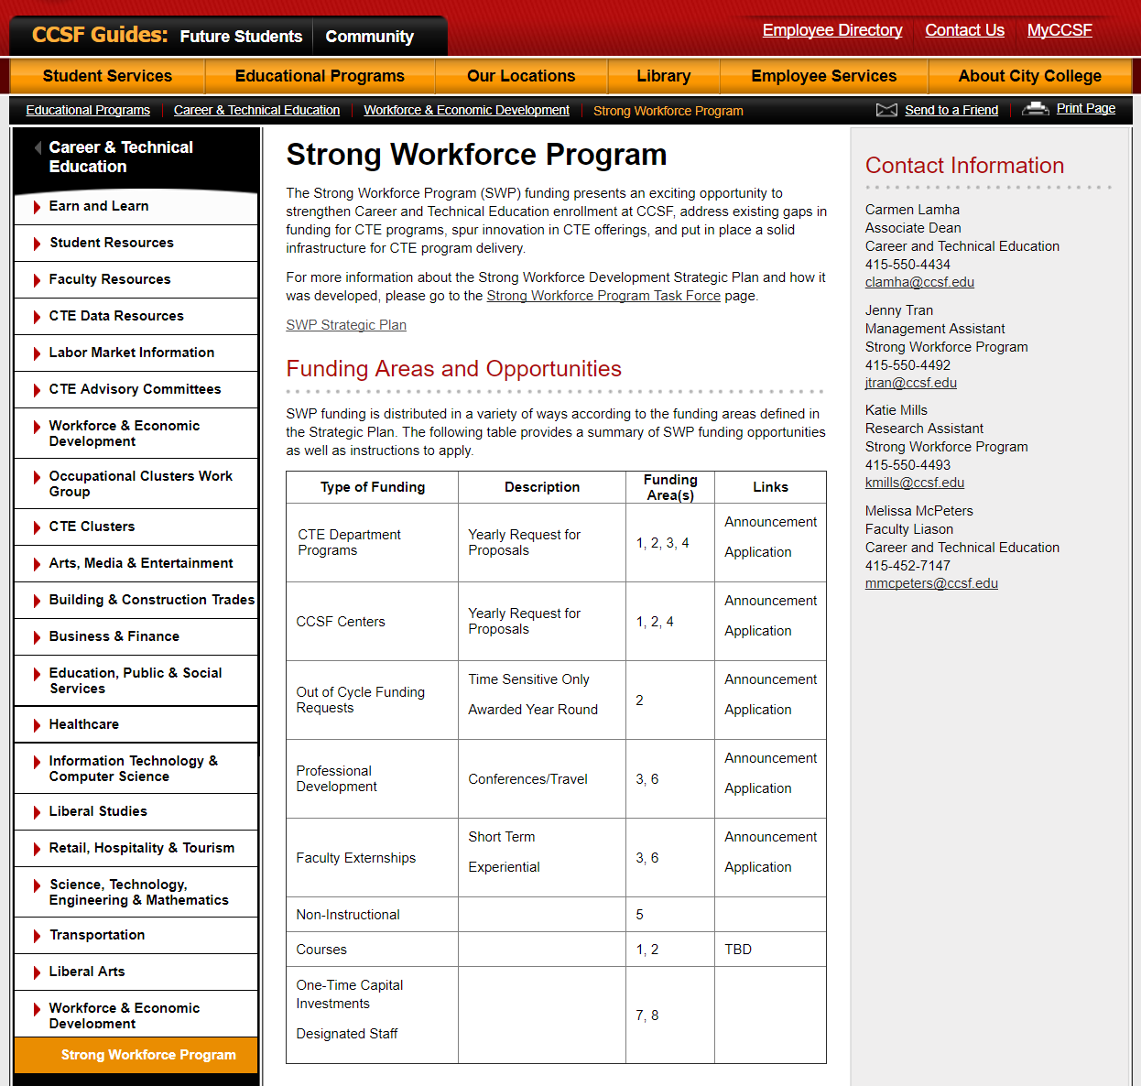
Strong Workforce Program Site www.ccsf.edu/swp
DRAFT

Slide 3
Strong Workforce Program Site
www.ccsf.edu/swp
DRAFT

Slide 4
Strong Workforce Program
Task Force
Strong Workforce Program (SWP) Task Force Membership, Fall 2016 -2020
Co-Chair: Theresa Rowland, Associate Vice Chancellor of Workforce and Economic Development
Co-Chair: Beth Cataldo, CTE Faculty Liaison to the State Academic Senate
Craig Persiko, Academic Senate CTE Steering Committee Co-Chair
Richard Wu, Academic Senate CTE Steering Committee Co-Chair
Lisa Romano, SSSP Coordinator
Neela Chatterjee, Equity Coordinator
Valerie Abaunza, Career Counselor
Olga Shvarts, Counselor, DSPS
Steven Brown, CTE Department Chair, Environmental Horticulture & Floristry
Terry Chapman, CTE Faculty, Construction & Building Maintenance
Alma Avila, CTE Faculty, Health Education
Brenna Stroud, CTE Student
Liz Leiserson, Staff from Research and Planning
Janel Hadden, Staff from Perkins Office
Geisce Le, Center Dean
Kimberly Harvell, Instructional Dean
Laura Lara-Brady, Associate Dean of Equity
Wendy Miller, Associate Dean AEBG
John Halpin, Associate Dean, Cooperative Work Experience
Tom Boegel, Associate Vice Chancellor Academic Affairs Faculty
Alternate Members (with voting privileges when #9, or 10, or #11 are absent)
Maura Devlin-Clancy, CTE Faculty, CNIT
Sheila McFarland, CTE Department Chair, BEMA
Jennifer Rudd, CTE Faculty, Culinary Resource
Faculty appointed by the Academic Senate:
(John) Malcolm Hillan, Environmental Horticulture & Floristry
Melissa McPeters, CTE Coordinator, City Build Academy; Basic Skills Math Faculty
Nick Rothman, CTE Faculty, Automotive
Kathleen White, CTE Faculty, Child Development

Slide 5
Strong Workforce Program Site
Funding Areas
1. Enrollment Development
2. Program Enhancement
3. Innovation
4. Infrastructure
5. Integrated Student Support Services and Instruction
6. Professional Development
7. One-Time Capital Investments
8. Designated Staff

Slide 6
Strong Workforce Program Site
www.ccsf.edu/swp
DRAFT

Slide 7
Strong Workforce Program Site
www.ccsf.edu/swp
DRAFT

Slide 8
Strong Workforce Program Site
www.ccsf.edu/swp
DRAFT

Slide 9
Strong Workforce Program Site
www.ccsf.edu/swp
DRAFT

Slide 10
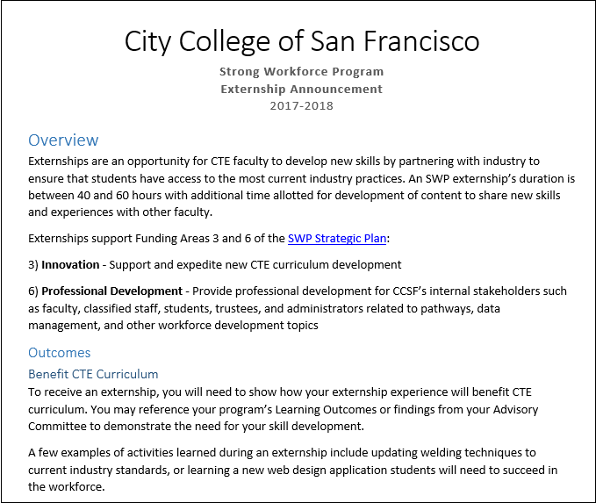
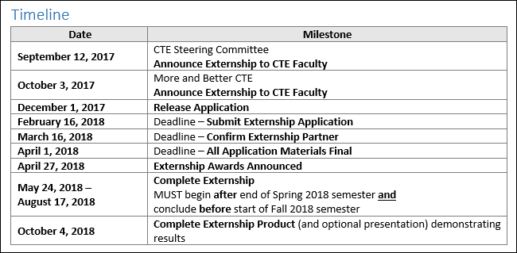
Strong Workforce Program Site
www.ccsf.edu/swp
DRAFT

Slide 11
Strong Workforce Program Site
www.ccsf.edu/swp
DRAFT

Slide 12
Strong Workforce Program Site
www.ccsf.edu/swp
DRAFT

Slide 13
Strong Workforce Program Site
www.ccsf.edu/swp
DRAFT

Slide 14
Strong Workforce Program Site
www.ccsf.edu/swp
Additional Information
More and Better CTE
Oct 3rd, MUB 140
State Chancellor’s Office 12:00 – 4:00 (tentative)
WED CCSF 4:00 – 6:00 (tentative)
Food and Refreshments

