Slide 1
CTE Committee Meeting
Improving our internal
Perkins allocation process
Friday, August 29, 2014

Slide 2
What works with our current internal Perkins allocation process?
RFA process
Timeline
Election of Allocation Subcommittee members from CTE Committee membership
Peer review of applications
Integrity and fairness of process

Slide 3
What is not working so well?
Proposals are inconsistent in content, length, and what is stressed
Proposals do not leverage other compliance work we do, such as program review
Current RFA format doesn’t allow room for folks to really explain their proposal
Process is paper-based

Slide 4
The goal
Give CTE programs the opportunity to tell their story and explain a program improvement proposal in a simple, clear narrative.
Provide tools that create consistency across proposals
Leverage program review to reduce work for CTE departments in applying for Perkins funds

Slide 5
What’s driving this bus?
Accreditation
Program review content and details specific to CTE programs
CCCCO compliance and reporting formats for Perkins funds

Slide 6
Accreditation
Make sure we are documenting CTE activities in a standardized way
Faculty role (ten+1)
Advisory committee membership list
Advisory committee meeting agendas and minutes
Implementation of changes based on advisories
Review of currency and relevance of courses, degrees and certificates every two years

Slide 7
Program review
Be able to use language and data from program review in the Perkins internal application.
Core Indicator reports and interpretation
Labor market data
Competitive programs in the region
Documentation of required biannual advisory meetings and input from advisors
Documentation of internal assessments (SLOs, PLOs, currency & relevance)
Identified areas for program improvement
Plans for addressing those issues
Resource requests and possible funding sources

Slide 8
Tell your story…
Our current RFA does not have space for applicants to provide a simple narrative or executive summary.
Statement of need
Description of proposed project
Anticipated outcomes
How outcomes will be measured

Slide 9
CCCCO Compliance
Make our internal application correspond to CCCCO requirements for our local application and reporting
What information requested on our internal application
Format of information on the application
Accountability for outcomes and quarterly progress reporting

Slide 10
The Perkins local online application is based on TOP code
The following information is needed for each funded TOP Code (not department or program):
Data elements:
Budget by expenditure categories 1000 – 7000
Core Indicator performance summary
Status of nine required uses of funds (met or unmet)

Slide 11
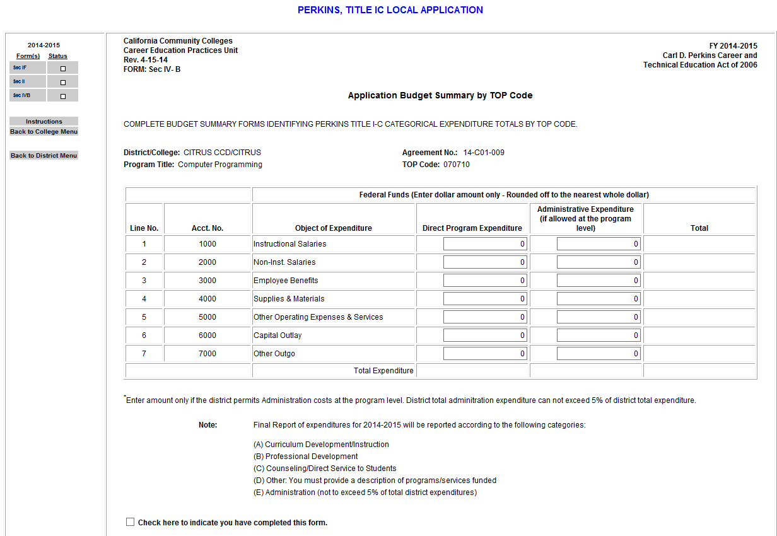

Slide 12
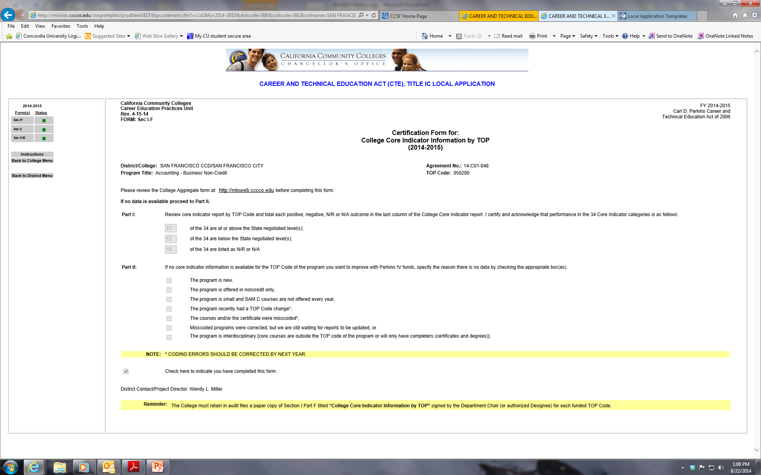

Slide 13
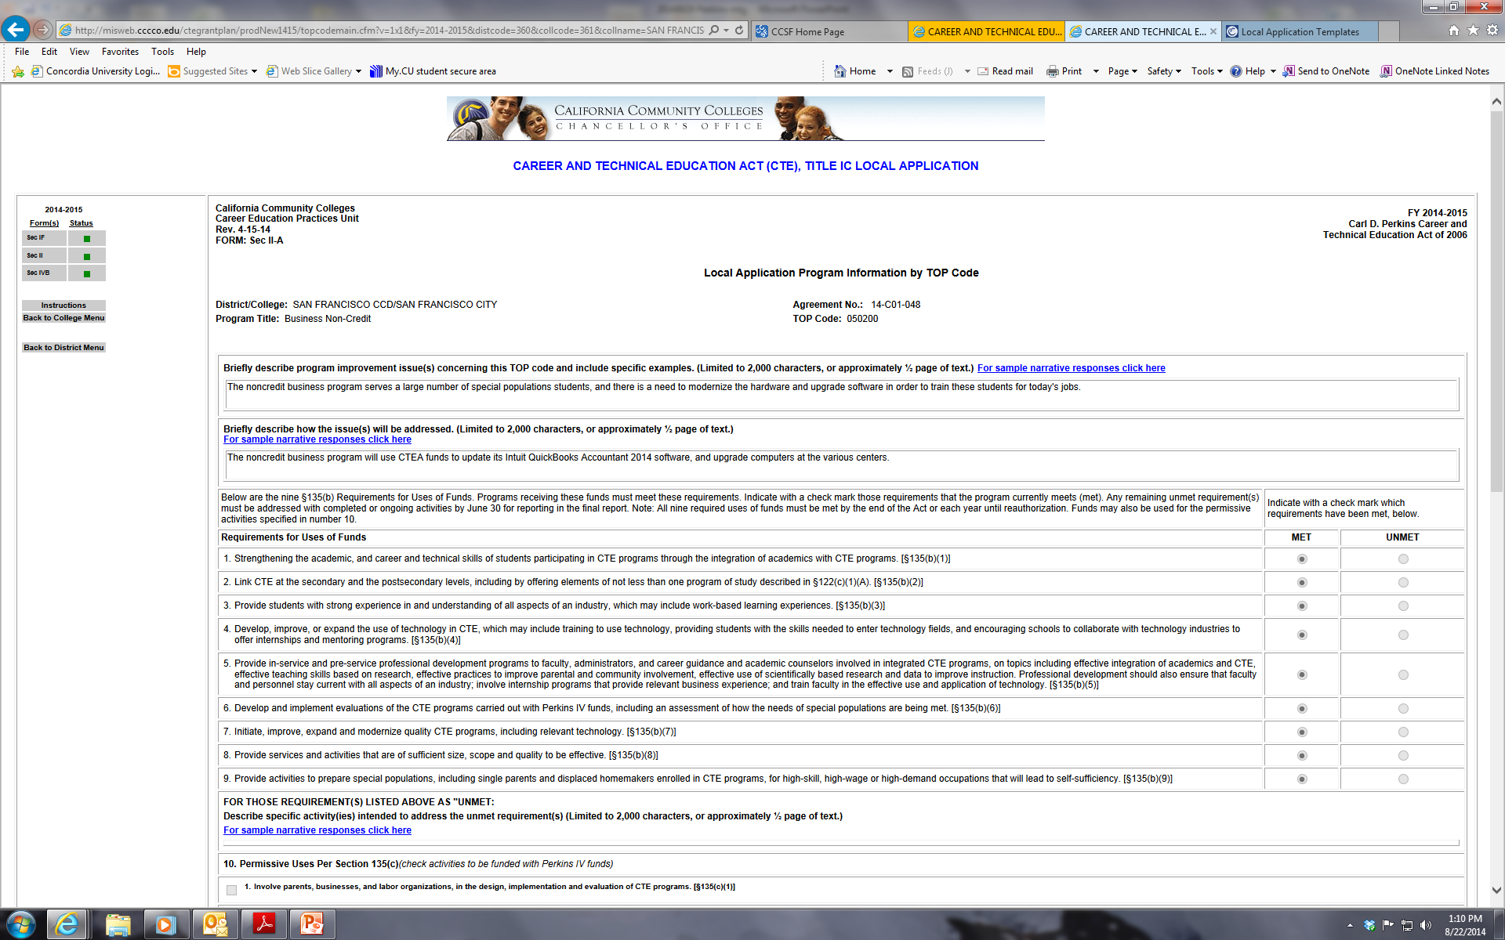

Slide 14
The Perkins local online application, continued
Narrative elements:
Identified program improvement issue(s)
How those issues will be addressed
Plans for unmet required uses of funds
Planned activities under 20 permissive uses of funds
Whether activities will be funded entirely with Perkins, or from other funding sources

Slide 15
The Perkins local online application, narrative Question 1
Briefly describe program improvement issue(s) concerning this TOP code and include specific examples.
(Limited to 2,000 characters, or approximately ½ page of text.)

Slide 16
The Perkins local online application, narrative Question 2
Briefly describe how the issue(s) will be addressed.
(Limited to 2,000 characters, or approximately ½ page of text.)

Slide 17
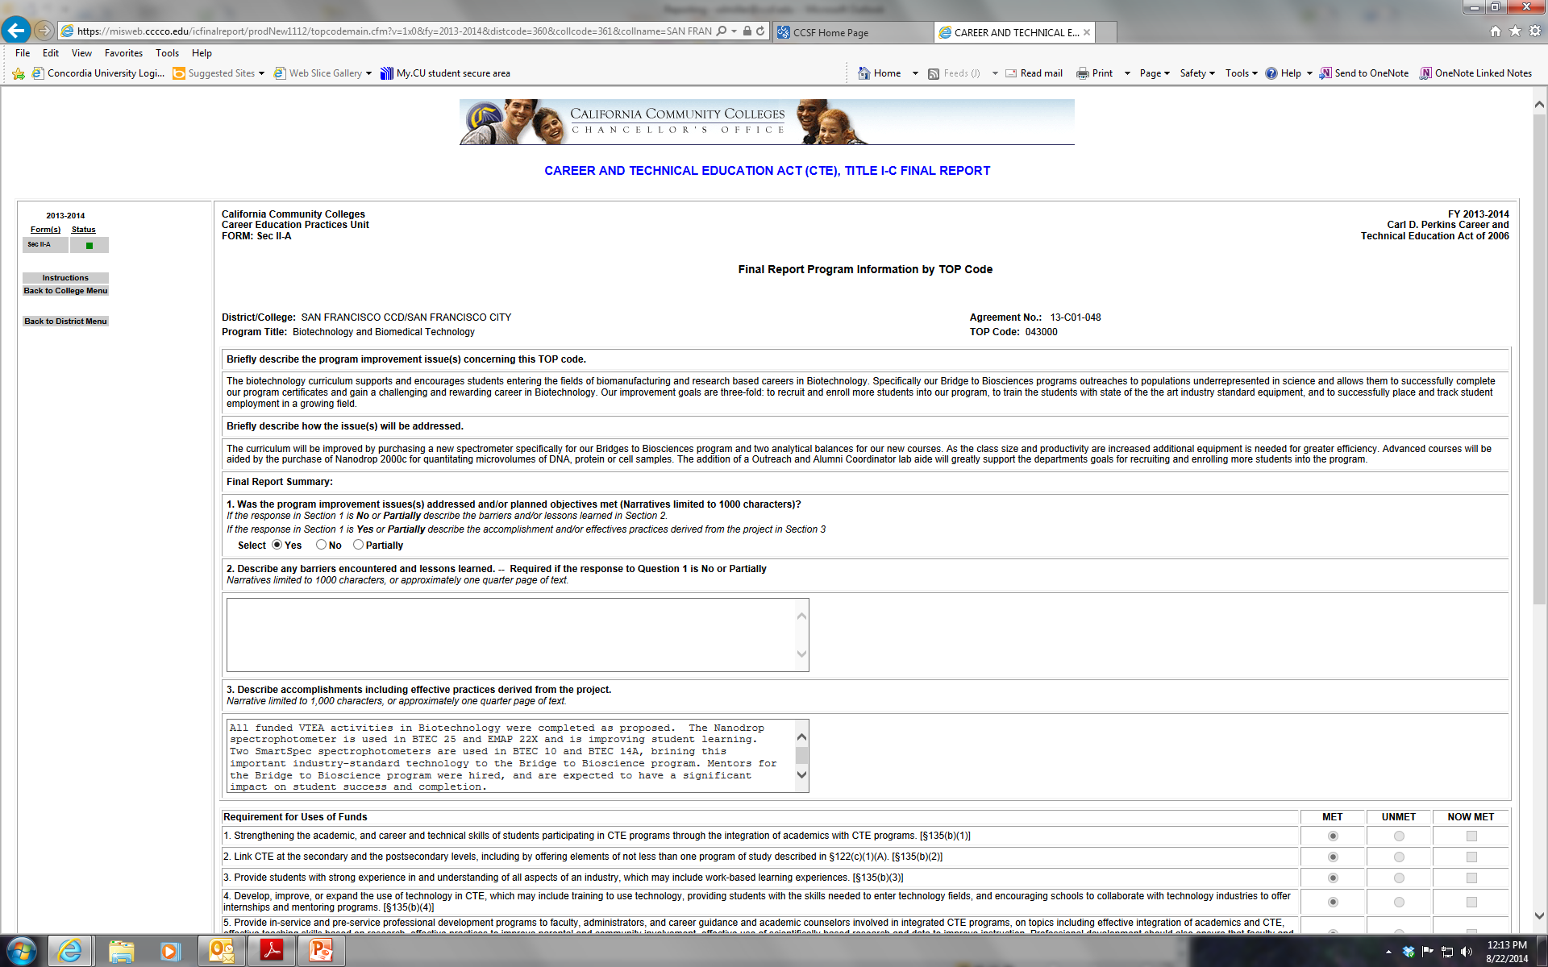

Slide 18
The Perkins local online application, narrative Question 3
For each of the 9 required uses of funds that is listed as "UNMET:
Describe specific activity(ies) intended to address the unmet requirement(s)
(Limited to 2,000 characters, or approximately ½ page of text.)

Slide 19
Proposed improvements
Format the RFA so proposals are more consistent and easier for readers to compare and rank
Consider using online tools for proposals
Include an executive summary
Connect format of RFA to CCCCO reporting format
Ask more questions on RFA that are more specific, and have character limits on answers
Provide direct links to Core Indicator data
Require funded proposals to report progress quarterly & at end of FY

Slide 20
Let’s discuss…
What are your ideas for improving our process?

