Slide 1

Enrollment Management Committee
12/19/2024
Budget Overview/Projections

Slide 2
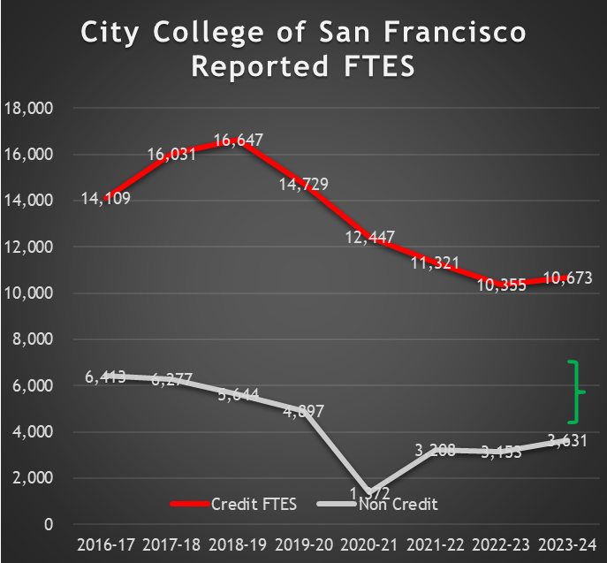
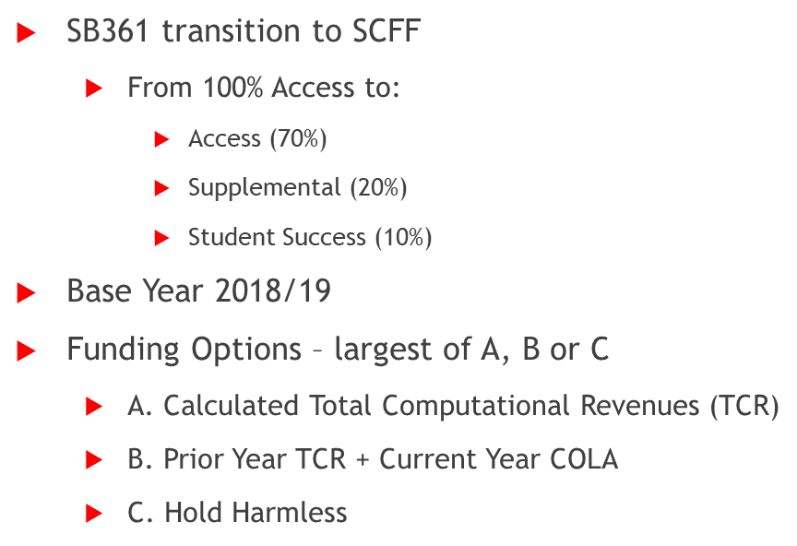


SCFF/Hold Harmless
Past/Moving Forward
HOLD Harmless
2017/18
Notes:
2024/25 Advance
18 Districts – Hold Harmless (Ohlone, Peralta, San Mateo, Marin, Sonoma, Foothill DeAnza, Monterey, Napa, West Valley)
44 Districts – Stability (Contra-Costa, San Jose, Solano)

Slide 3
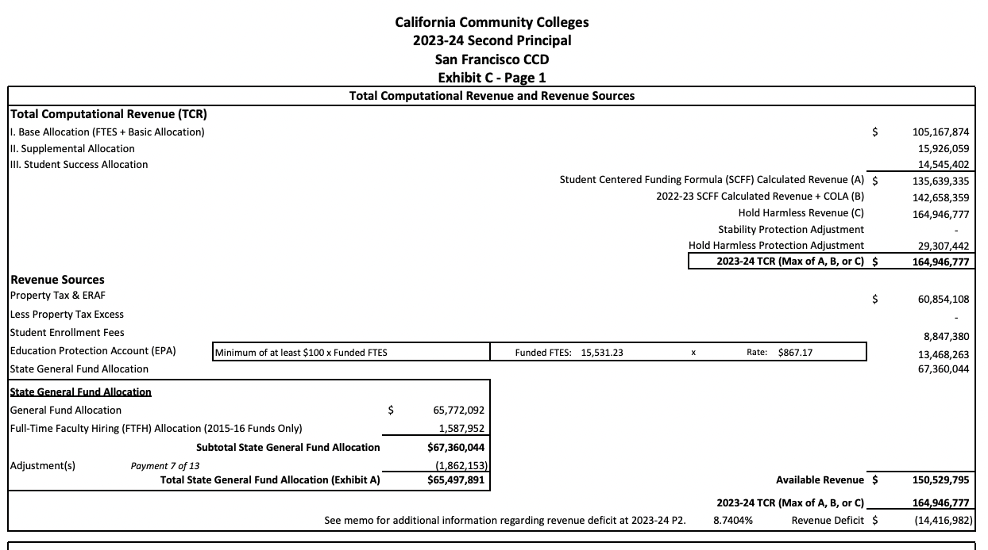

Slide 4
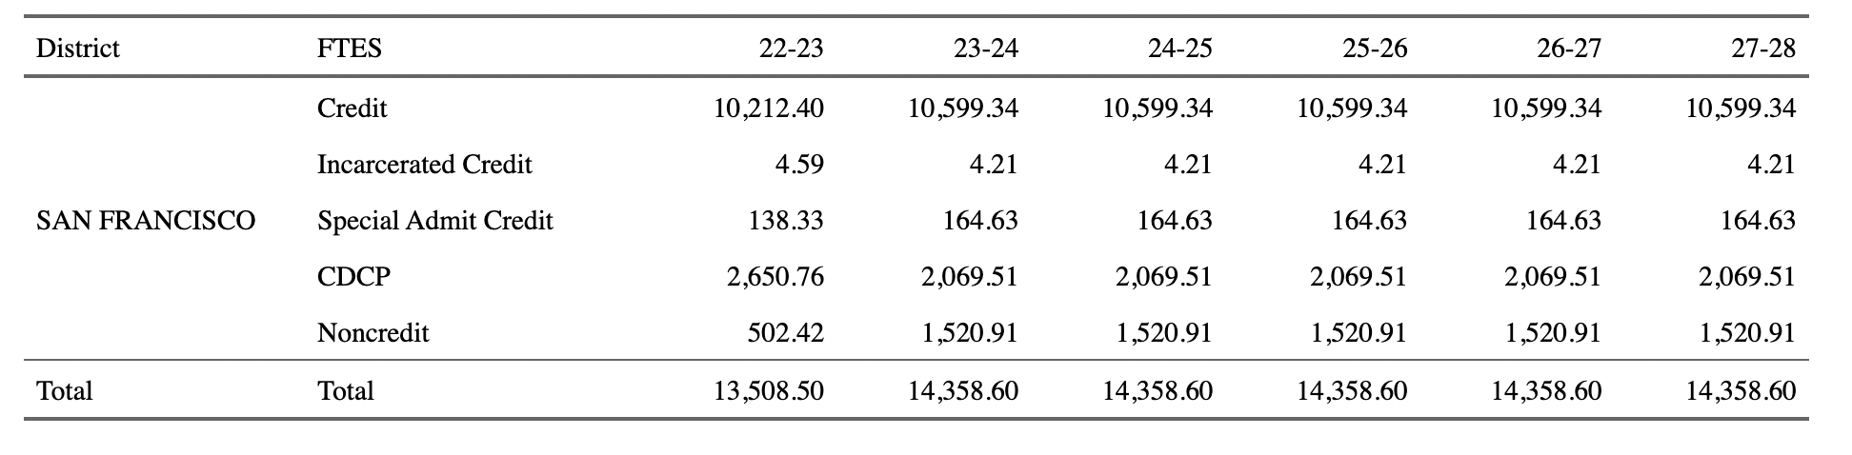

Slide 5
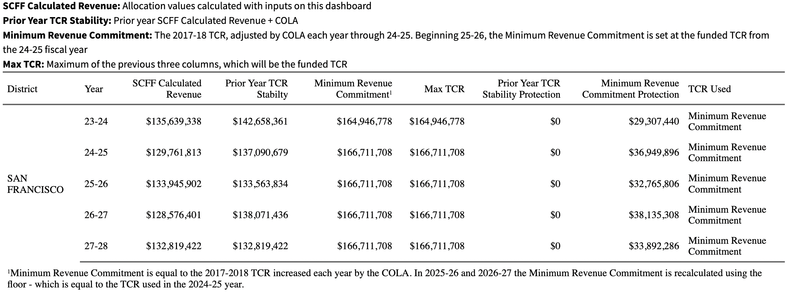

Slide 6
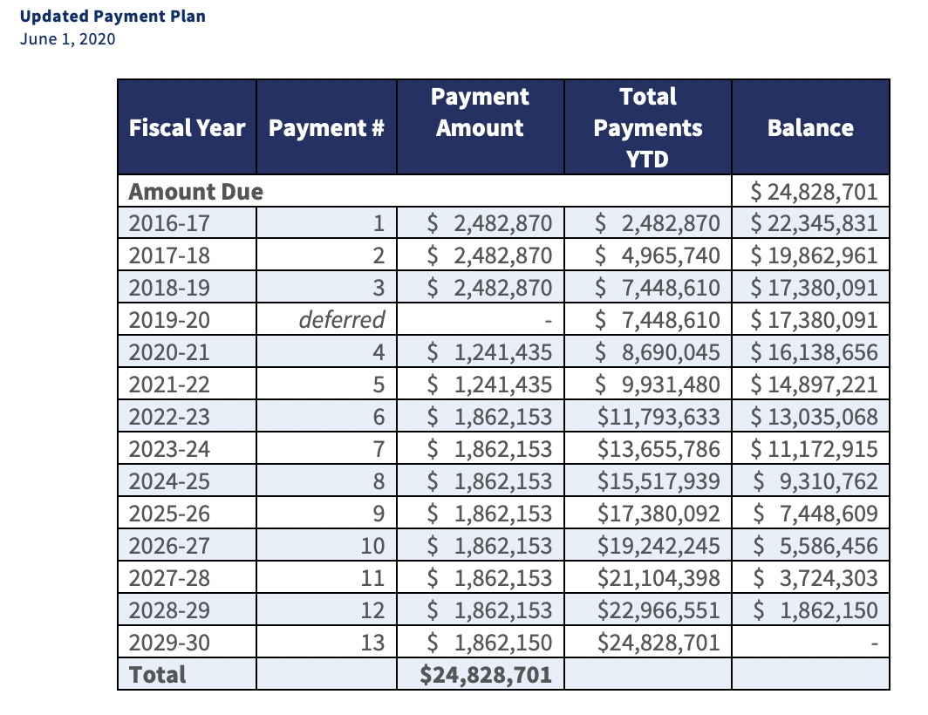
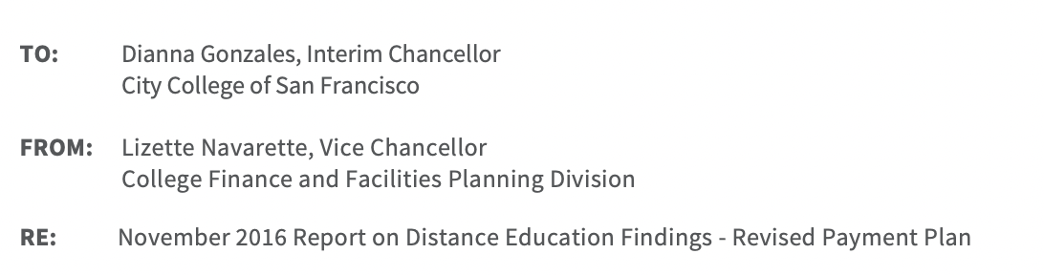

Slide 7
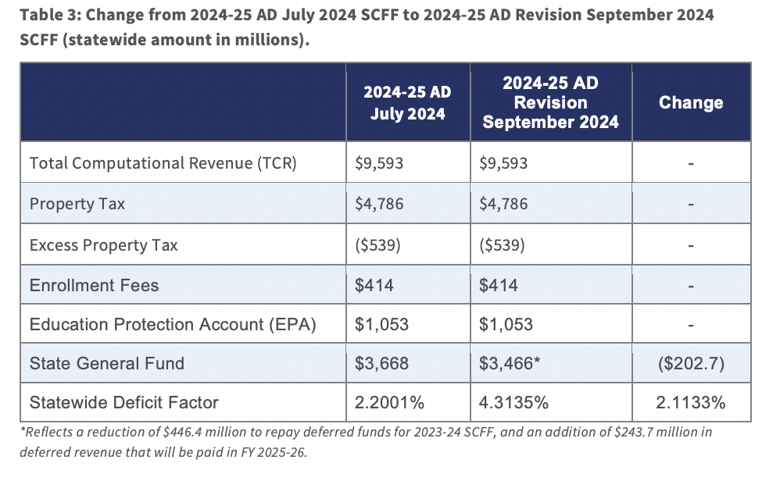

Slide 8
