Slide 1
Google Workspaces

Slide 2
Google Notice
Feb 2021 – New Workspace for Education Storage Policy announced by Google
April 2021 – Google contacted CCSF of the mandated changes in storage allocation and started a resource partnership for achieving the revised storage goals
July 2022 – Previous deadline to be at 163TB storage limit for CCSF’s Google Workspace Account. Granted 6-month extension due to CCSF’s extraordinary efforts
Jan 2023 – Current deadline to meet 163TB limit

Slide 3
Google Workspaces History
Past | Present | Future
Unlimited Storage and Email to all CCSF applicants | Policies in place to limit access to storage to “confirmed” students | Storage usage must remain below 163TB* or less
340,000 Non-Active Google Workspace Student accounts were deleted (last registered class was over 3 years prior) | 421,000TB in April 2021 to 105TB in January 2023 | Improved automation to account provisioning and de-provisioning process
Top 5 Student Accounts came into compliance by Oct 24, 2022 (350TB used) | 1GB quota applied to all student accounts | Employee storage quotas
 | CCSFmail Standards and Guidelines published

Slide 4
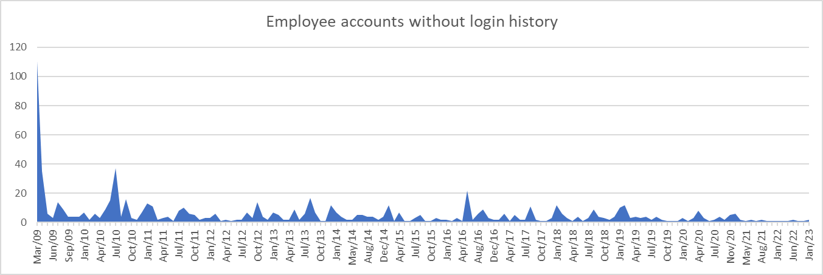
Employee Accounts
Total Accounts = 2857
Accounts with no login history = 805
Created within the Past 90 days = 3
Created within the Past 12 months = 9
Created over 1 year = 796

Slide 5
Assistance?
CCSFmail FAQ: https://www.ccsf.edu/about-ccsf/administration/finance-and-administration/information-technology-services/ccsfmail-faq-students
CCSF Intranet: https://www.ccsf.edu/intranet
Helpdesk:
https://helpdesk.ccsf.edu
helpdesk@ccsf.edu
24 x 7 x 365 via telephone
On Campus dial 611 or 3711
Off Campus 415-239-3711
Toll Free 877-379-2491

