Slide 1

DSPS 101: Accommodations, UDL and Accessibility.
Presenters:
Olga Shvarts, Part Time DSPS Counselor
Terence Chuck, Full Time DSPS Counselor
This Photo by Unknown Author is licensed under CC BY-ND

Slide 2
DSPS Role at CCSF
Determine educational accommodations for students who request services based on disability information provided and interactive process
Advise college community on accommodations, fundamental alteration and accessibility matters.
Share responsibility for providing accessible educational environment to students in collaboration with administration, instructors and classified
Provide accessibility tools and training to students

Slide 3
Different Populations and Implications
Life long/ long term disabilities vs recent/ temporary conditions
Online Services vs In-person services/ classes
HS Students vs Adults
Ocean Campus vs Other campuses
Medical Conditions
People from other cultures
Veterans
Homeless Individuals

Slide 4
Disclosure, Nondisclosure and Confidentiality
* Not all students with disabilities will want to register with DSPS.
* DSPS registration is voluntary.
* Student disclosing disability to faculty/staff = student disclosing to the institution.
* If they don't disclose, don't assume, even if its obvious.
* Never identify a student as a DSPS student in public or in class
* Rather than assuming students may benefit from specific services, provide general information about available services in the syllabus, on Canvas and in first class meeting.
TAKEAWAY: Unless disclosed and accommodation is requested, focus should be general provision of information.

Slide 5
DSPS Process Overview
This process takes one meeting if student has medical / disability information already. It may take longer if they do not.
Step 1
Students contact our office to request appointment and meeting with a counselor is scheduled
Step 2
During appointment DSPS counselor uses interactive process to determine eligibility for services and appropriate accommodations
Step 3
Accommodation letter – CATAV- generated and provided to student to share with instructors or classified at the college ( testing, tutoring)
Other information and referrals are provided

Slide 6

Typical Accommodations
Extra Time on Exams and/ or Testing in with Reduced Distractions ( 1 ½ or double time)
Preferential Seating/ Reserved Seating/ Furniture
Hearing Amplification device/ teacher use microphone
Sign language interpreter/ captioning
Notetaker/ and/ or Audio Record Lectures
          Accommodations that require additional interactive process
Extra Time on Assignments
Flexibility with attendance policy
Replacement of specific assignment with another
Aide in class
Course waiver and substitutions

Slide 7
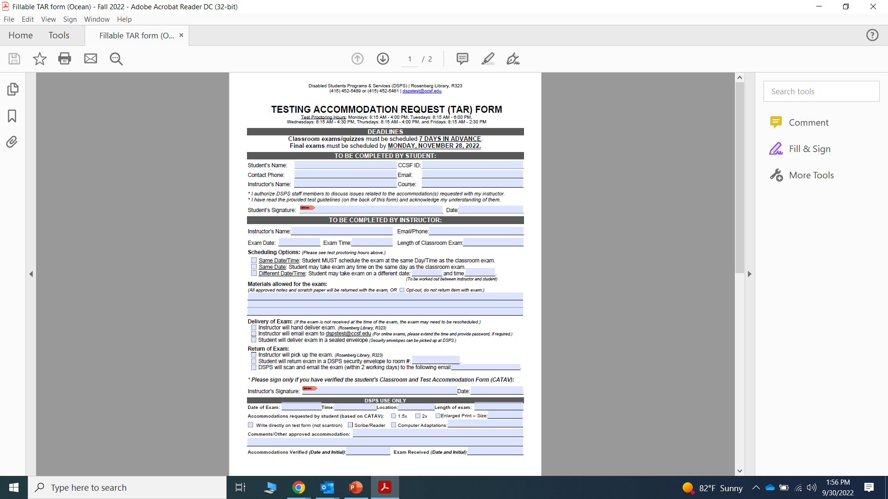
A screen shot of the current
Testing Accommodation Request form available on the DSPS website
Notes:
A screen shot of the current
Testing Accommodation Request form available on the DSPS website

Slide 8
Important Terms To Know- Interactive Process
Interactive Process
The ADA and Title 5 require that DSPS certificated staff engages in the ‘interactive process” as part of the development of an Academic Accommodation Plan (AAP) to determine the most appropriate accommodations for the student.
The interactive process requires communication and good-faith exploration between DSPS and individual students. The shared goal is to identify appropriate academic adjustments and/or auxiliary aids or services that facilitate equal access to the educational process.
Instructor Role in the Interactive Process
The instructor’s role in the interactive process is to share their knowledge of the essential elements of the course or program.
It is also the instructor’s role to contact the DSPS if they believe that the recommended academic accommodation may compromise the essential requirements of a course/program or constitute a fundamental alteration to a course/program.
This determination usually involves your department chairperson or dean.

Slide 9
Important Terms To Know- Fundamental Alteration
Decision should be made:
In coordination with DSPS, through a meaningful, informed, interactive and collaborative process on a case-by-case basis.
By a group of people who are trained, knowledgeable and experienced in the subject, course, field of study area.
After consideration of a series of alternatives as essential requirements.
With a careful, thoughtful and rational review of the academic program and its requirements.
While considering a specific student.
Fundamental Alteration
A change to a college course or program that is so significant that it alters the essential nature of learning outcome, class or program. (removing/ waiving acquisition of a skill that is considered essential or is directly related to the health and safety of others. Excusing or waiving requirements directly related to licensing requirements)
The Office for Civil Rights has provided guidance in determining if an accommodation request constitutes a fundamental alteration.

Slide 10
Vignettes to Discuss
You are teaching a Beginner Japanese class. Your quizzes and exams test both an expressive and receptive language components. The students hear different words and must write the correct symbol to show they understand the word. You have a student who has no use of his arms and requests an accommodation for quizzes and tests. What would be a good accommodation? How can you make the class more accessible? Is this a fundamental alteration?
You are a teacher in a Basic Culinary Skills class. You have a student who has requested an accommodation not to work around knives. How would you go about delivering this accommodation? Is this a fundamental alteration?
You are teaching a math class and you have weekly assignments that you grade. You have a student who regularly asks for time extensions on these assignments. Your syllabus states that you do not accept late assignments. Is this a fundamental alteration? How can you make class more accessible?

Slide 11
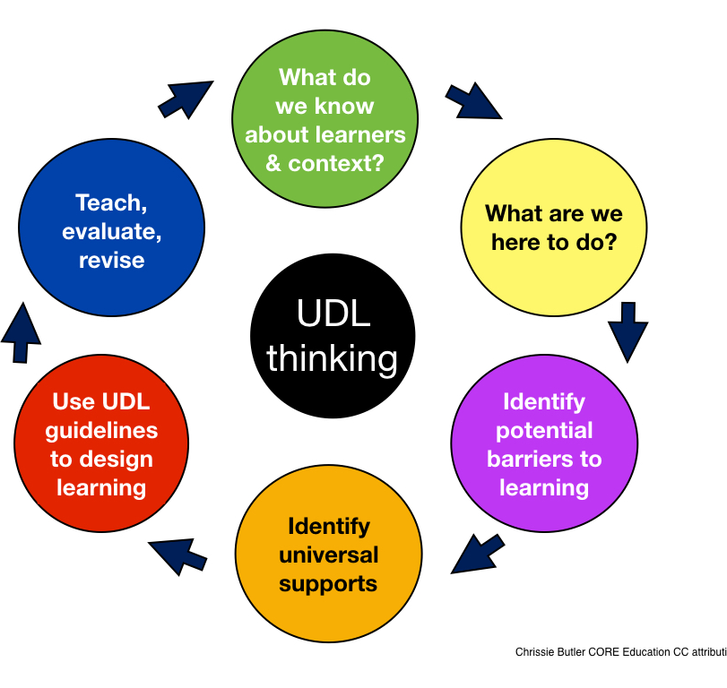
Accommodations vs.
Accessibility and Universal Design
Accommodations are reactive solutions to address special cases.
Accessibility is a proactive solution to providing equal access for all. Pursuing accessibility means starting the design process with accessibility in mind, not applying principles of accessibility after the fact or only when special cases merit attention. Accessibility is about anticipating the needs of all students and providing them with the best opportunity to succeed. It benefits all students, those with or without disability. It is in alignment with diversity and inclusion principles we are striving to implement.
This Photo by Unknown Author is licensed under CC BY-SA

Slide 12
Accessibility and UDL focus on inclusive educational practices.
Ensuring all students (including those with disabilities) have access to content, while providing multiple options to acquire information are key to student success.
Provides flexibility in the ways information is presented, in the ways students respond or demonstrate knowledge and skills, and in the ways students are engaged
Reduces barriers in instruction, provides appropriate accommodations, supports, and challenges
Maintains high achievement expectations for all students, including students with disabilities and students who are limited English proficient.

Slide 13

Assessing for Accessibility
Informally evaluate if your class for accessibility by asking yourself how would a blind, deaf or quadriplegic person do this assignment or complete this requirement.
If gaps are evident, note what they are and incrementally work to find substitutions/ solutions.
Setting standards (time or deadlines) helps provide accommodations. Extra time is provided at 1/1/2 or double time of a standard time for a student. That way if extra time for DSPS student is requested, that can be provided based on some clear expressed standard, otherwise it will appear like discrimination/ unfair advantage.
Strive to spend a few minutes with a DSPS students privately to determining what part of your class are least accessible to them or most difficult to them. You may discover information that you may not have previously considered.
Have prepared resources to help you refer students for support and to provide accessibility services if requested in a confident manner.
List deadlines that the college sets for midterm/ final grade submission on syllabus so that you can refer to it when/ if you are granting time extension on assignment.
This Photo by Unknown Author is licensed under CC BY-SA-NC

Slide 14
The UDL Lens of Access, Engage and Express TM
Access by transforming usable information into usable knowledge through: digital media print touch audio visual media | Engage with contents and concepts using: interactives problem-solving designing video graphics collaborating reflection | Express my understanding through: writing presenting storytelling multimedia building/making making sense of learning
The UDL Lens of Access, Engage and Express is an express trademark of Kathleen MClaskey. All rights reserved. Reference: How to Personalize Learning by Bray and MClaskey, 2016. http:/y.bit/Learner-Profile

Slide 15

Examples of UDL in online class
When designing an online course, an accessibility mindset
Prepare podcasts and video lectures along with transcripts and/or captions.
Posting images with concise and meaningful alt tags.
Ensuring that documents are in pdf format and legible with a screen reader.
This Photo by Unknown Author is licensed under CC BY

Slide 16
LEARN MORE ABOUT UDL
CAST - Center for Applied Special Technology
National Center on Universal Design for Learning

Slide 17
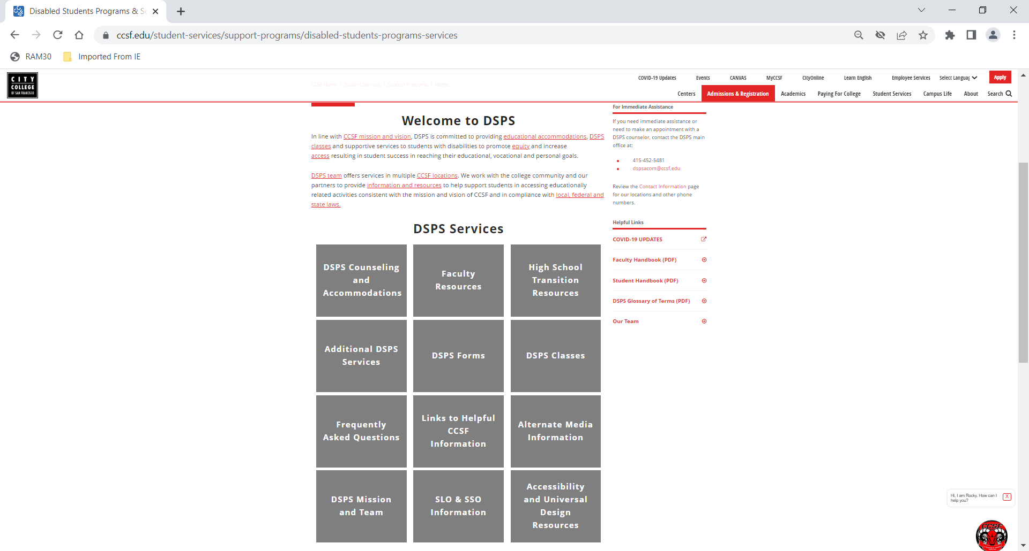
DSPS Website Updates

Slide 18
Introducing - Simplicity
In efforts to modernize the accommodation request process with a fully ADA-compliant interface DSPS has purchased Simplicity Software
It will allow for entirely online and secure document management
Accommodations requests and services delivered virtually ( for those who can)
Easier information exchange between instructors, students and DSPS staff
Timeline
Initial and IT set up – Fall 2022
Training of DSPS Staff and Faculty - Spring 2023
Training of CCSF Faculty and Students – end of Spring- Summer 2023
Roll out campus wide and additional training– Fall 2023

Slide 19

Q & A Time

